Slide 1
SCREEN TIME IN A CRISIS
Unė Žemaitytė
Turing College Data Analytics Course

Slide 2
Does the number of increased notifications during the current situation increase screen time?

Slide 3
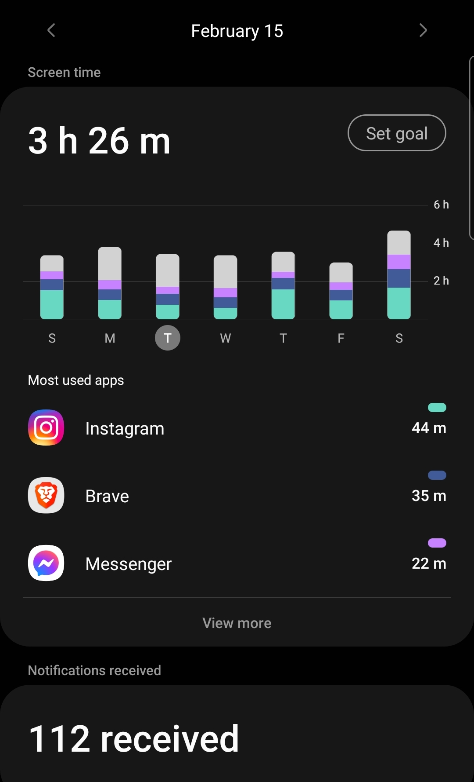
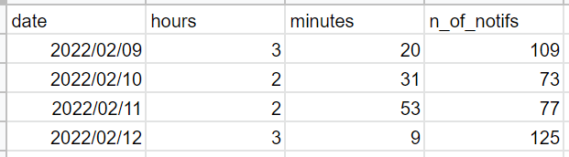
Data collection
Data was obtained from the Digital Wellbeing app on my Samsung Galaxy smartphone, which tracks the overall time spent using the smartphone, number of received notifications, and time spent on any app individually on a given day.

Slide 4
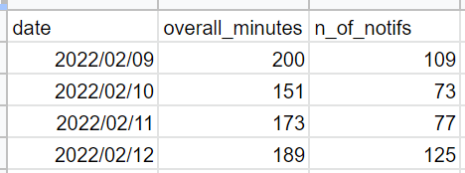
Cleaning the data
overall screen time = (‘hours’ * 60) + ‘minutes’
date – day the data was recorded
hours and minutes – time spent looking at a smartphone screen
n_of_notifs – number of notifications received

Slide 5
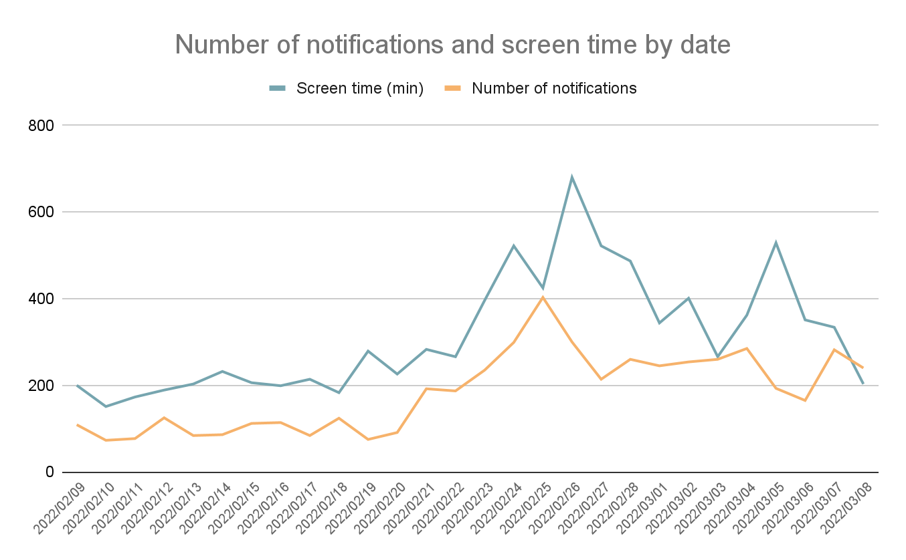
Results: number of notifications and screen time by date

Slide 6
Results: number of notifications and screen time by date
Start of Russian invasion in Ukraine

Slide 7
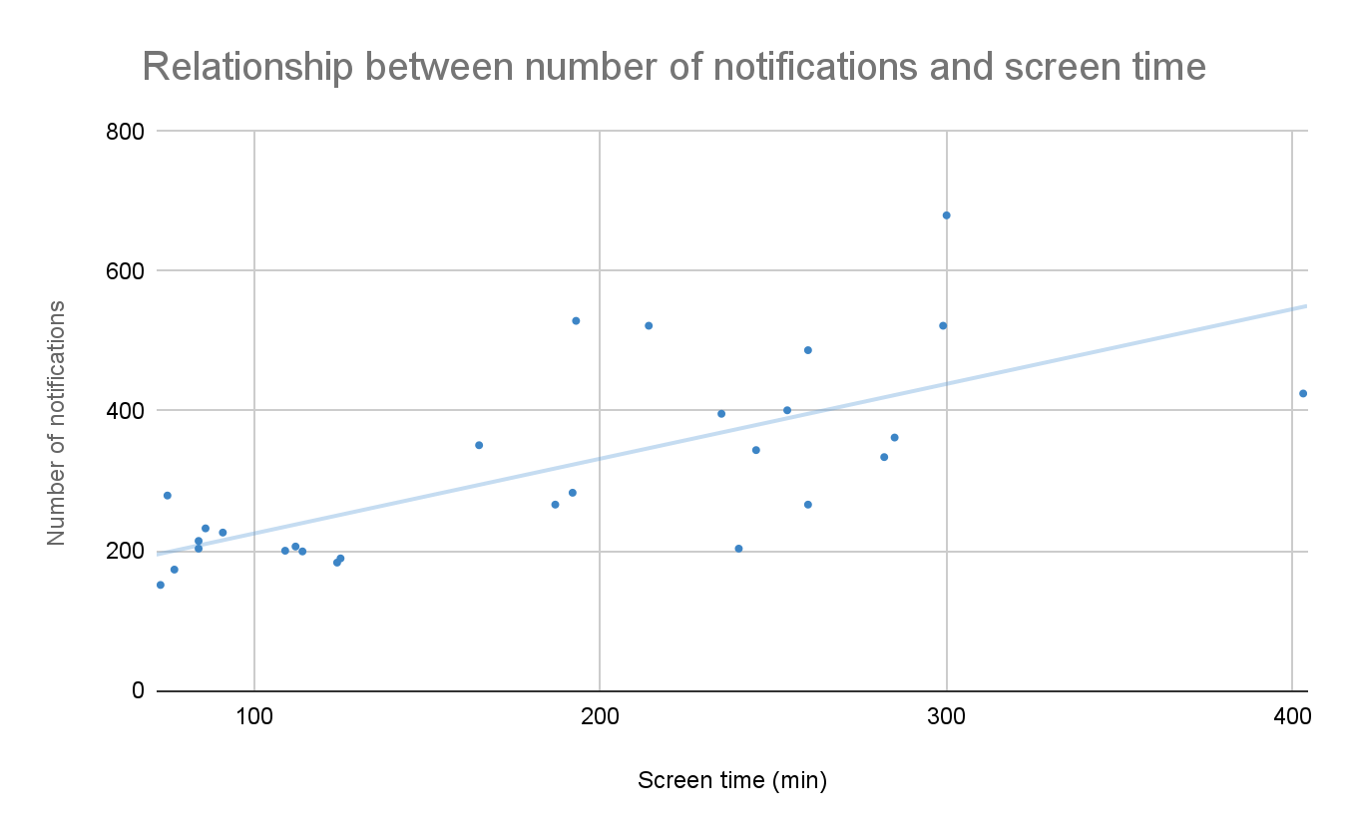
Results: the relationship between number of notifications and screen time

Slide 8
CONCLUSIONS
The overall screen time and number of notifications increased since the invasion began
There is a relationship between the number of notifications received and time spent looking at a screen

Slide 9
CONCLUSIONS
The overall screen time and number of notifications increased since the invasion began
There is a relationship between the number of notifications received and time spent looking at a screen
WHAT CAN BE DONE?
Turn off smartphone notifications to prevent information overload
Set a daily screen time limit

Slide 10
SCREEN TIME IN A CRISIS
Unė Žemaitytė
Data analytics

